Slide 1





AUTOMATED DIAGNOSIS AND QUANTIFICATION OF KNEE OSTEOARTHRITIS
UNDER THE SUPERVISION OF
Dr. Rajiv Kumar
Associate Professor
Dr. Vibha Jain
Assistant Professor - I
PRESENTED BY : KARTIK JOSHI
8024320057

Slide 2

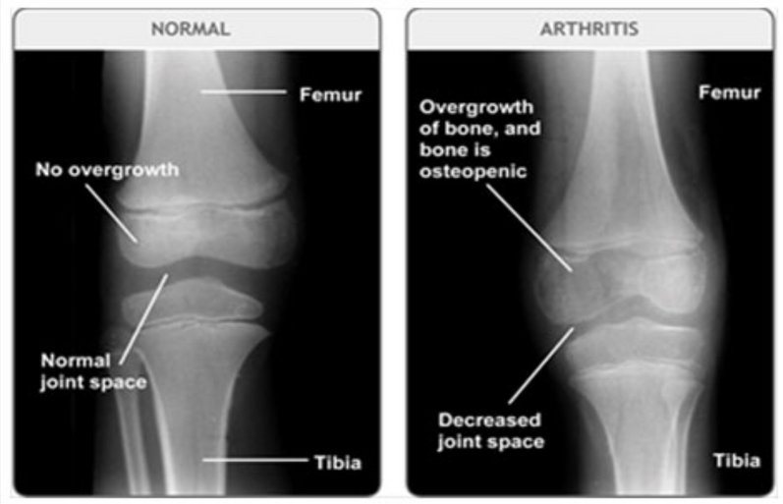
INTRODUCTION
  Knee Osteoarthritis (KOA) is a degenerative joint disease affecting the cartilage between femur and tibia.
  It causes pain, stiffness, and reduced mobility, especially in weight-bearing joints.
  Diagnosis depends on manual X-ray grading, which is subjective.
  Early joint changes are difficult to detect visually.
  A need exists for an automated and objective diagnostic system.

Slide 3
KL GRADING SYSTEM
Kellgren–Lawrence (KL) grading is the clinical standard for KOA severity.
  Most widely accepted clinical standard for KOA diagnosis.
  Based on structural changes seen in X-ray images.
  Higher grade = greater cartilage loss and disability.
SEVERITY LEVELS :
  Grade 0 — Normal
  Grade 1 — Early signs, doubtful
  Grade 2 — Mild OA, visible osteophytes
  Grade 3 — Moderate OA, clear JSN
  Grade 4 — Severe OA, near bone-on-bone
Joint Space Width (JSW) is a key measurable indicator in grading.

Slide 4
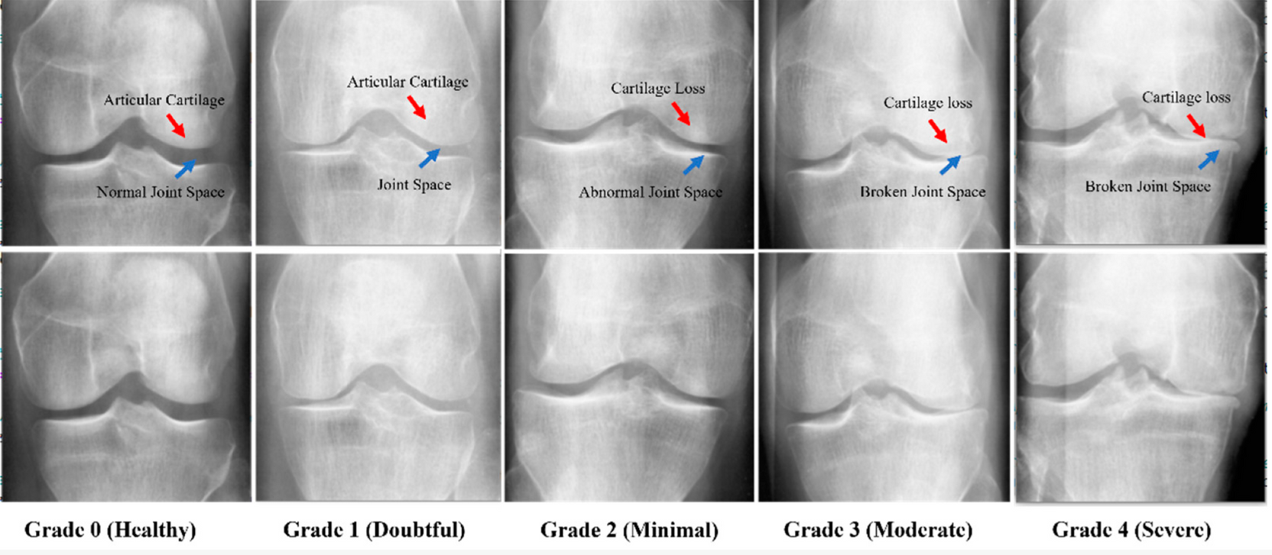
KL GRADING SYSTEM STRUCTURE

Slide 5
PROBLEM STATEMENT
PROBLEM 1
PROBLEM 2
Existing KOA models provide only severity labels without measuring JSW.
Lack of a combined classification + quantification system reduces clinical usability.

Slide 6
PROBLEM STATEMENT
PROBLEM 3
PROBLEM 4
Need for a high accuracy, reliable, and generalizable AI model due to variability in X-rays.
Requirement for objective assessment of disease progression rather than subjective visual grading.

Slide 7
OBJECTIVES
01
To gather and organize a high-quality KOA X-ray dataset & design a robust preprocessing and augmentation pipeline to enhance image clarity, highlight clinical features, and ensure balanced class representation.
02
To develop a high-accuracy Ensemble CNN model for automated KOA severity classification using EfficientNet, DenseNet121, InceptionV3, and MobileNetV2.
03
To implement Mask R-CNN based segmentation for precise Joint Space Width (JSW) measurement and validate clinical reliability through IoU and performance metrics.

Slide 8
LITERATURE REVIEW
Result | Title | Dataset Used | Methodology Used | Relevance to Project
2–8% improvement vs. single CNN models | Deep Ensemble Network for Quantification and Severity Assessment of Knee Osteoarthritis | OAI X-ray Dataset | Proposed ensemble of multiple CNN models for KOA X-ray classification, achieving better performance than individual models. | Supports our CNN based architecture approach for reliable KOA grading
Femoral cartilage Dice Score: 80% | Improved-Mask R-CNN: Towards an Accurate Generic MSK MRI Instance Segmentation Platform | OAI subset | Applied Mask R-CNN for precise musculoskeletal region segmentation with high Dice Score. | Validates Mask R-CNN segmentation for JSW measurement

Slide 9
LITERATURE REVIEW
Result | Title | Dataset Used | Methodology Used | Relevance to Project
Higher accuracy & recall than single networks | Ensemble CNN Model for Computer-Aided Knee Osteoarthritis Diagnosis | Public KOA datasets | Used a hybrid ensemble of deep CNNs (InceptionResNetV2 + Xception) to increase accuracy and minimize misclassification. | Confirms ensemble-based decision fusion increases classification reliability.
91.03% accuracy | Automatic Classification of the Severity of Knee Osteoarthritis Using Enhanced Image Sharpening and CNN | OAI X-ray | Showed that CLAHE preprocessing improves bone clarity and boosts classification performance from 72% to 91%. | Validates our CLAHE-based preprocessing pipeline to enhance X-ray visibility.

Slide 10
METHODOLOGY
DATA ACQUISITION & PREPARATION
Data Source: Mendeley Data (derived from the OAI) provides the Knee Osteoarthritis
Severity Grading Dataset used by the system. 8,260 X-ray pictures with Kellgren-
Lawrence (KL) grade labels.
  Class Simplification : The original five-class system was combined into three strong categories to enhance clinical decision-making :
Healthy : (Grades 0, 1, 2)
Moderate : (Grade 3)
Severe : (Grade 4)
  Stratified split: Train 70% | Validation 10% | Test 20%

Slide 11
DISTRIBUTION OF DATA FOR CLASSIFICATION
Testing Set | Validation Set | Total Images | Disease Grade | KL Grade | Training Set
639 | 328 | 3253 | Healthy | Grade 0 | 2286
296 | 153 | 1495 | Doubtful | Grade 1 | 1046
447 | 212 | 2175 | Minimal | Grade 2 | 1516
223 | 106 | 1086 | Moderate | Grade 3 | 757
51 | 27 | 251 | Severe | Grade 4 | 173
1656 | 826 | 8260 | Total | All Grades | 5778

Slide 12
ANNOTATED IMAGES FOR SEGMENTATION
Subset | Number of Images | Purpose
Training Set | 876 | Used to train the Mask RC to create knee joint space polygon masks.
Validation Set | 109 | Used to adjust the mask heads and assess the Intersection over Union (IoU) score.
Total | 985 | Total number of photos with annotations utilized for the segmentation task.

Slide 13
METHODOLOGY
DATA PREPROCESSING & TRAINING
Image Enhancement & Class Balancing
  Median Filtering for noise removal while preserving bone edges.
  CLAHE for local contrast normalization and joint-space clarity.
  Augmentation applied to under-represented classes to maintain dataset balance.
KOA Classification (Ensemble CNN)
  Trained EfficientNetB5, DenseNet121, MobileNetV2, InceptionV3 individually.
  Averaging Ensemble (Hard Voting) improves reliability & reduces misclassification.

Slide 14
METHODOLOGY
DATA SEGMENTATION
Segmentation Using Mask R-CNN
  Mask R-CNN trained to extract the knee joint space (ROI) at pixel-level precision.
  Manual annotation used to create binary masks for training.
.
Quantitative JSW Measurement & Clinical Validation
Direct clinical consultation with Dr. Mudit Sharma (Orthopedic Surgeon), MAMC, New Delhi helps to identify real clinical challenges, especially :
  Need for objective millimeter-level JSW measurement in treatment planning.
  His feedback led to the integration of Mask R-CNN for precise segmentation and quantitative JSW results.
  Outputs an objective Joint Space Width value for severity assessment.

Slide 15
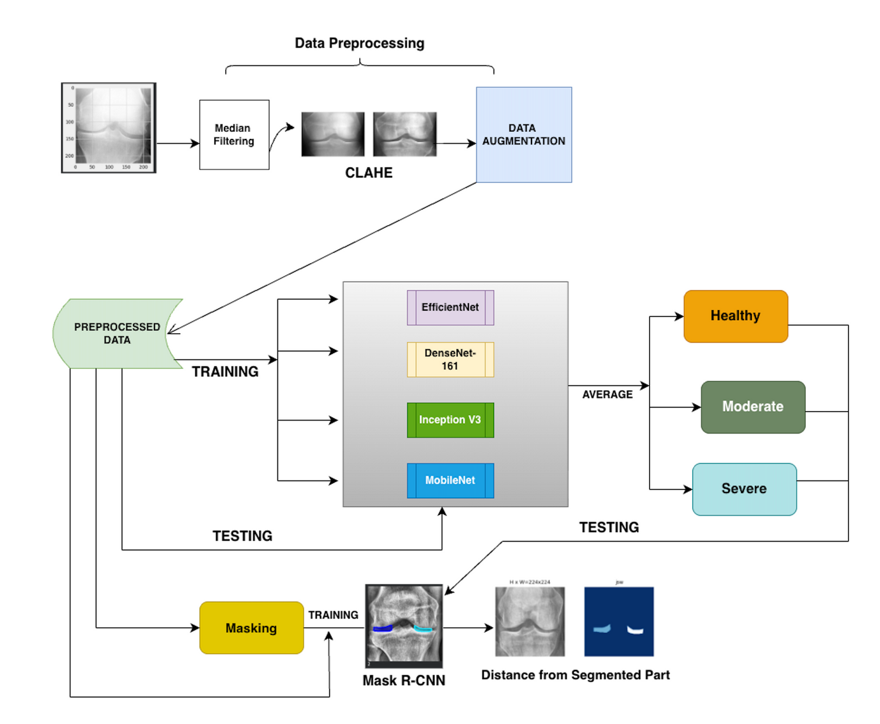
SYSTEM ARCHITECTURE

Slide 16
RESULTS
  Ensemble CNN model achieved 99.03% accuracy, 99.02% precision, 99.03% recall, 99.02% F1-score — highest among all models.
  Best single model: DenseNet121 with 94.87% accuracy (still ~4–5% lower than ensemble)
  Other individual CNNs (EfficientNetB5, InceptionV3, MobileNetV2) scored ~94% accuracy each.
  Mask R-CNN segmentation achieved IoU = 0.7321, effectively extracting knee joint region for JSW calculation.
  Output visuals (classification + segmentation + JSW distance) confirmed correct detection and region extraction during evaluation.

Slide 17
LIMITATIONS
  Running four CNNs + Mask R-CNN increases inference time and requires high-end GPU/cloud for real-time deployment.
  Segmentation accuracy depends on annotation quality, and manually labeled masks can introduce minor human error.
  Strong class imbalance and limited demographic diversity may reduce model reliability for severe and rare deformities.
  Only imaging is considered — no patient symptoms, pain score, or clinical history used for prediction.

Slide 18
FUTURE WORK
  Reduce computational load by optimizing ensemble size and deploying lightweight architectures for real-time clinical use on standard hospital systems.
  Improve reliability of JSW measurement by incorporating 3D or multi-view imaging to overcome limitations of 2D X-ray projections.
  Expand dataset diversity by including more severe OA cases and wider demographics to improve generalization across populations.
  Integrate multimodal clinical information such as pain score, age, BMI, and medical history for more accurate and personalized diagnosis.
  Develop a universal diagnostic application supporting hip, hand, and other joints with real-time decision support for orthopedic practice.

Slide 19
THANK YOU

